Slide 1
Personal Property Tax
What to Look for when Processing your Tangibles and Valuing Boats
November 19, 2020
Kentucky Department of Revenue • 501 High Street • Frankfort, KY 40601 • (502) 564-2557

Slide 2
Reviewing Tangibles

Slide 3
Pre Audit Before a return is entered into the system, the following “pre-audit” checks should be performed to ensure an accurate record and reduce data entry time.
Check for complete taxpayer identification number. If the taxpayer neglects to provide a social security or FEIN number, an attempt should be made to obtain it. Please avoid using a 99-9999999. Check to see if a return was filed in previous years with FEIN/SSN.
Verify that the property location given is a street address or location in your county.
Record the proper tax district code
Verify all computations for mathematical accuracy. Go through the return and make certain that an values listed on the schedules are carried over to the front page of the return.

Slide 4
Pre Audit (cont.) Before a return is entered into the system, the following “pre-audit” checks should be performed to ensure an accurate record and reduce data entry time.
Check to see if the ‘Alternative Valuation’ box is checked on the front page. If so, enter the return as filed and forward a copy of the return to Jehna Cornish.
Verify that the current year factors are being used on the schedules. If you find that they are using the incorrect factors, enter the return as filed and forward a copy of the return to Jehna Cornish.
Returns postmarked on or before May 15th MUST be entered in locally. Your office may receive returns with a timely postmark after the deadline and the postmark date should be honored.
Late filed returns can be mailed State Valuation or email/Moveit to Jehna.Cornish@ky.gov. Please be sure to include a copy of the envelope with postmark or stamp when return was received in office.

Slide 5
Alternative Valuations
If a taxpayer believes that the index factors in the return have overvalued or undervalued the property, the taxpayer may petition the Department of Revenue to accept an alternative reporting method.
In most cases, the taxpayer sends these returns directly to the PVA instead of DOR. You’ll often find that taxpayers fail to check the “Alternative Valuation” box on the front of the return. When reviewing the return you should check to see if the current year factors are being used on the schedules.
The PVA should enter as filed and send a copy of the return to Jehna Cornish at Jehna.Cornish@ky.gov. Do not correct the factors on the filed return.

Slide 6
How to check if a return is an Alternative Valuation?
Check the schedules to make sure the current year factors are being used.
Current year factors
WRONG factors
Note: The factors change every year.
If you receive a return with the wrong factors, enter the return as filed and send a copy to Jehna.Cornish@ky.gov

Slide 7
Clerical Errors on Timely Filed Returns
133.110 Correction of clerical errors in assessment.
After submission of the final real property recapitulation or certification of the personal property assessment, the property valuation administrator may correct clerical, mathematical, or procedural errors in an assessment or any duplication of assessment. Changes in assessed value based on appraisal methodology or opinion of value shall not be valid.

Slide 8
A-Bill or Exonerations
Exonerations are made when clerical errors, mathematical errors, unintentional omissions, or duplications have been made on a taxpayer's bill. Revenue Form 62A366, Executive Order Correcting Erroneous Assessment, is used to correct a tax bill that is not yet delinquent.
The PVA will prepare a special exoneration form used when a refund is involved (62A366-R), which will describe the reason an assessment adjustment is being made and the amount of the change.
Some PVA offices have their own generated forms for A bills or additional bills related to clerical errors and duplications.

Slide 9
Error Examples
Clerical
Duplication
Unintentional Omissions
Mathematical
Return sent to the wrong county. When reached correct county tax roll was closed. Return was completed correctly by taxpayer.
Returns misplaced
Stapled together
Errors made in data entry of returns
Return entered twice

Slide 10
Correcting Errors
Complete the appropriate form for your PVA office.
Send exoneration and/or A-bill to the sheriff
Send copy exoneration and/or A bill and a copy of the return to OPV.
**OPV will create a ‘dummy’ assessment in the OPT database with a note stating that a bill was created at the local level due to a clerical error. This allows us to see that a bill was created and help avoid any unnecessary requests for returns or requests for an audit.

Slide 11
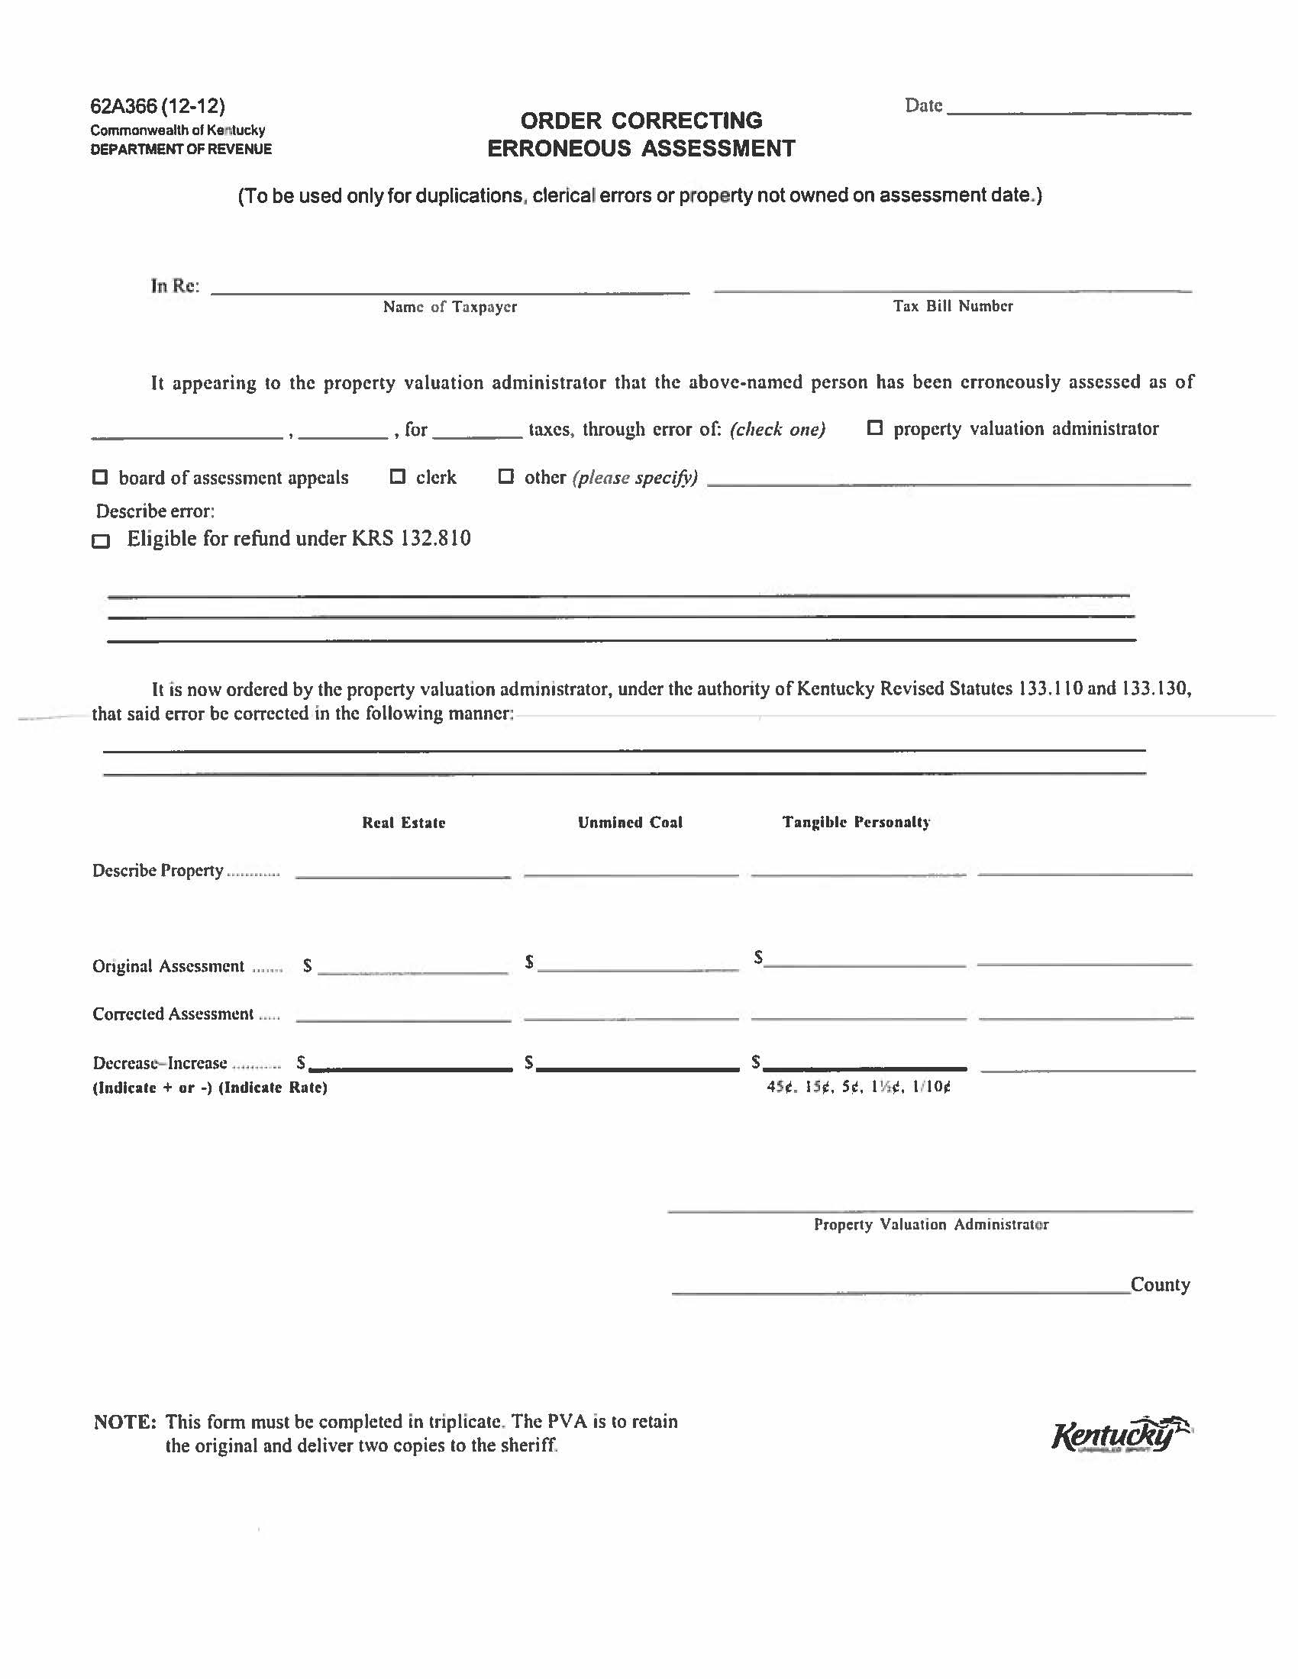

Slide 12
Correcting Errors
If a taxpayer files an amended return to add property because they omitted property on their original return (Ex: left off inventory) it is omitted property and should be sent to DOR if the tax roll has been closed.
If your tax roll is still open and a taxpayer filed an amended return because property was left off the original you can adjust the return in the system prior to closing.

Slide 13
Amended Returns
Taxpayers who discover an error was made on their personal property tax return can file and amended return along with an explanation of why the return is being amended and documentation to support the amended return.
Amended returns resulting in a possible refund should be filed within 2 years from the date of payment in accordance with KRS 134.590

Slide 14
What should the taxpayer provide?
Corrected 62A500-Tangible Personal Property Tax return
Documentation
Examples but not limited to
Fixed asset listing
Depreciation schedules
Inventory records
Refund request and/or application- if the amendment is resulting in a possible refund
KRS 134.590 (2) No state government agency shall authorize a refund unless each taxpayer individually applies for a refund within two (2) years from the date the taxpayer paid the tax. Each claim or application for a refund shall be in writing and state the specific grounds upon which it is based.

Slide 15
When to forward to OPV for review?
Complex amended returns
Alternative Valuations
When the taxpayer doesn’t provide an explanation or documentation.
Increase in assessment that was filed after the May 15th deadline. These are considered omitted and should be processed by OPV.
**If the amendment is clear, simple and you feel comfortable with the exoneration, please feel free to process without OPV authorization.**

Slide 16
Valuing Boats

Slide 17
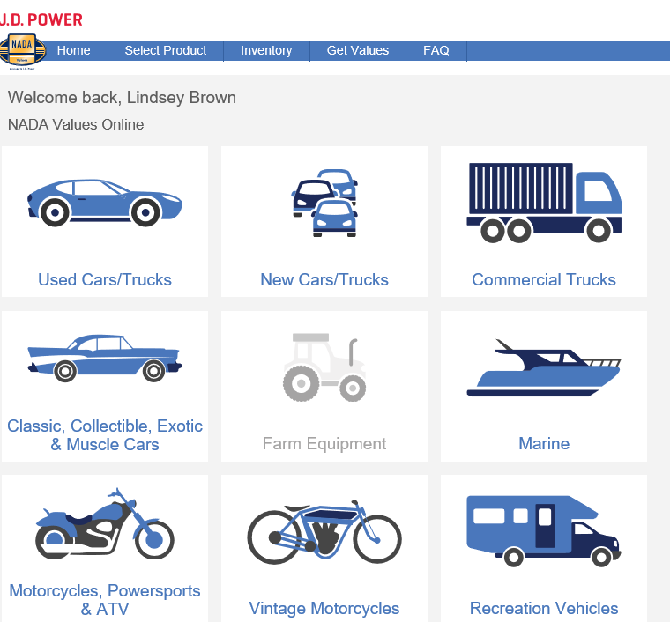
NADA E-valuator
https://extapps.nada.com/NadaOnline
Select Marine

Slide 18
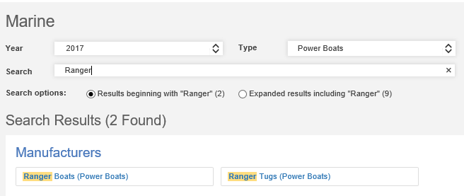
NADA E-valuator
Select Year, Type and enter make in the search box.
Example #1: Boat, Motor & Trailer included

Slide 19
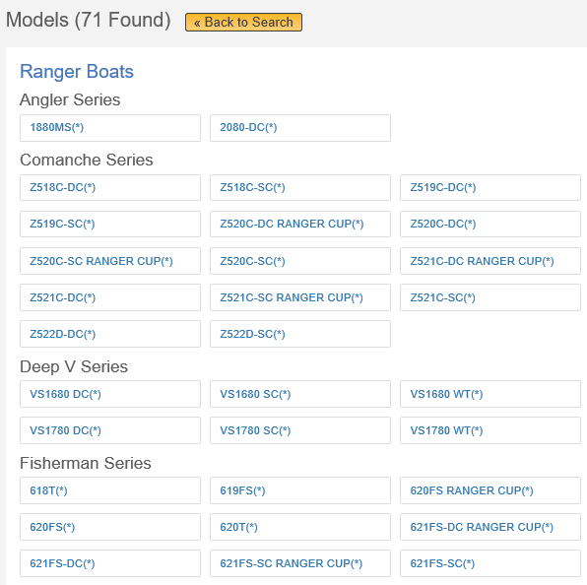
NADA E-valuator
Select boat that meets your criteria
Be sure to pay attention to vehicle notes.

Slide 20
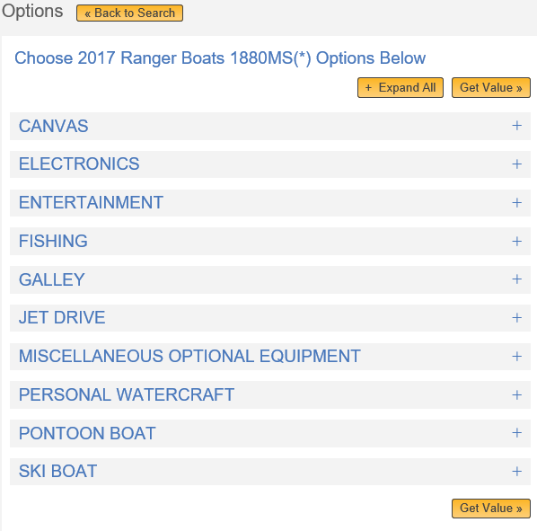
NADA E-valuator
Select ‘Get Value’.
If any of the extra option are known, you would add those here.

Slide 21
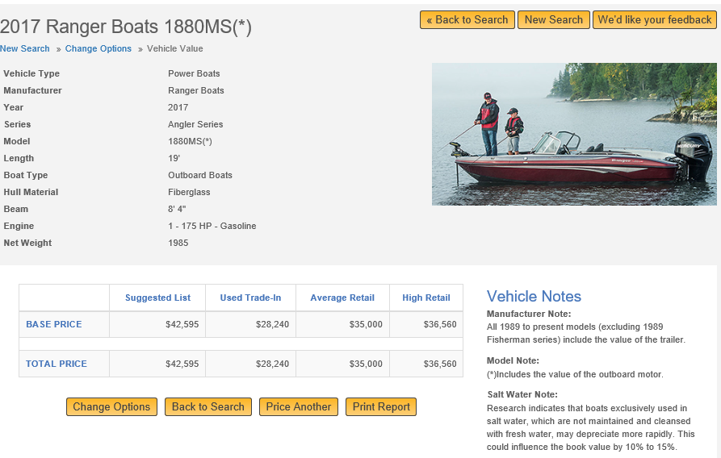
NADA E-valuator
Boats should be assessed at the Used Trade-In Value.
The NADA value is a guide and you can deviate from this value if additional information is available. KRS 132.485(1)(a)

Slide 22
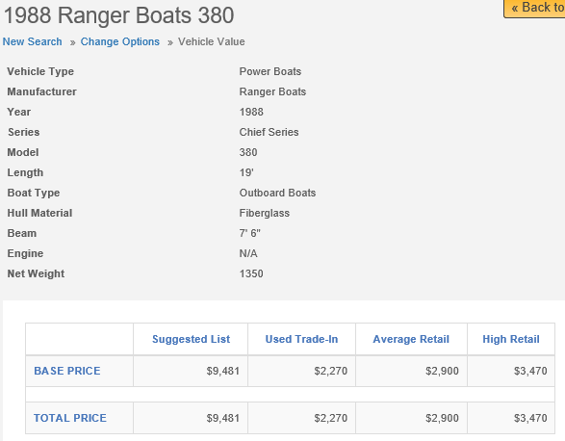
NADA E-valuator- Boat
Example 2: Boat, Motor and Trailer valued individually
Note: The vehicle notes indicate that this value doesn’t include the trailer or motor.

Slide 23
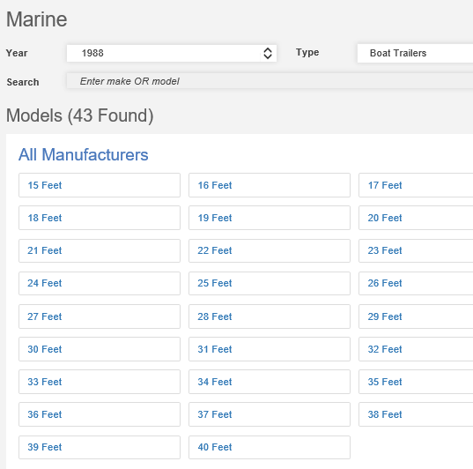
NADA E-valuator- Trailer
Select the year, Boat Trailers & length.

Slide 24
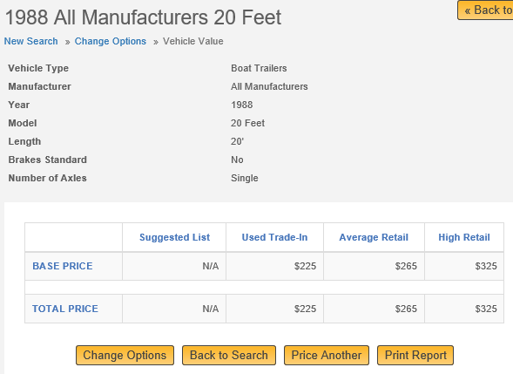
NADA E-valuator- Trailer

Slide 25
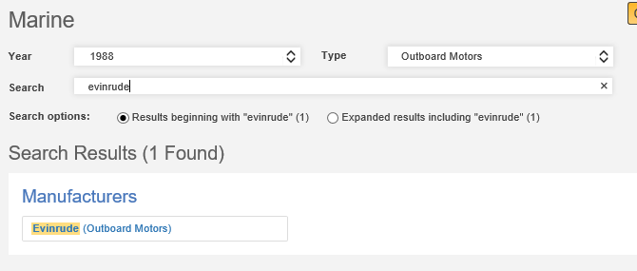
NADA E-valuator- Motor
Click Here
Select year, type and enter make of motor in ‘Search’.

Slide 26
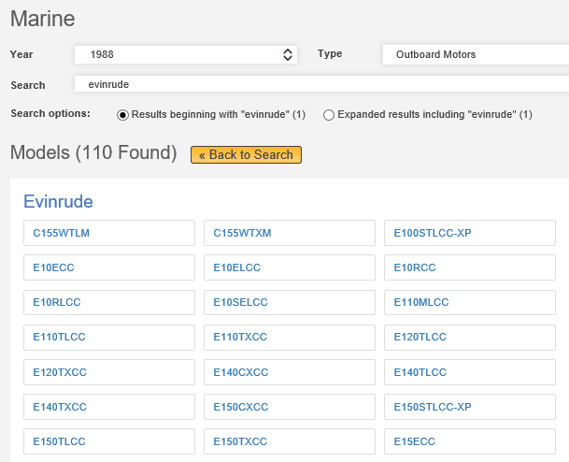
NADA E-valuator- Motor
Select motor that meets your criteria

Slide 27
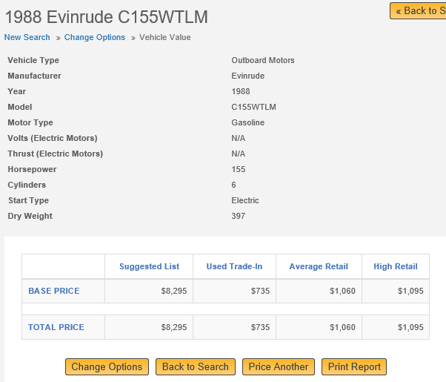
NADA E-valuator- Motor

Slide 28
NADA E-valuator
Example 2: Boat, Motor and Trailer valued individually
Boat $2270 NADA E-valuator Power Boats
Trailer $ 225 NADA E-valuator Boat Trailer
Motor $ 735 NADA E-valuator Outboard Motors
Total $3230

Slide 29
NADA Marine Guide
The Marine guide is divided into multiple sections including:
- Boats
- Outboard Motors
- Trailers
- Inboard Motors
As with the E-valuator version some values include the trailer, motor and other equipment combinations. It is important to review the headings for each manufacturer to determine what value option is used for their models.
If you are reviewing a boat model that does not include the combination options it will be necessary to use the manual to determine an individual value for the boat, motor and trailer to complete the assessment.

Slide 30
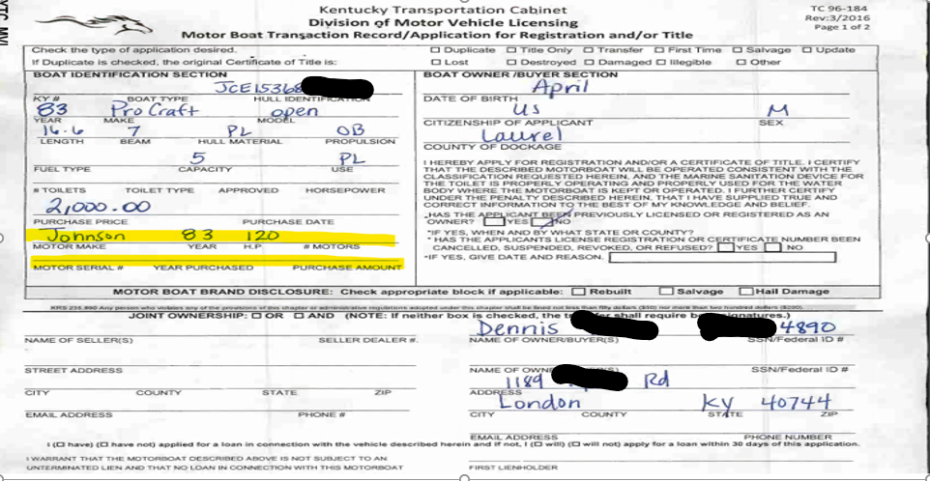
PODD BTR
The make of the motor can be found here.
If the purchase price of the boat and motor is available, you will enter separately in KAVIS.

Slide 31
Remember!
All boats require the PVA to value the first year the boat is in the AVIS system. Unlike vehicles, there’s no NADA tape that runs to automatically value the boat.
Its important to work your ‘Tax District Assignment Queue’ report in KAVIS since there is no automated boat tape. This report includes records that are missing a district code and/or value
The system will automatically depreciate the entered assessed value of a boat by 5% each year.
When the value of a boat drops below $100 it will not continue to depreciate the value by 5%.
To avoid issues with the KAVIS system and incorrect boat assessments, do not enter a value of $1 or $2 in the boat or motor fields in the KAVIS Ad Valorem segments.

Slide 32
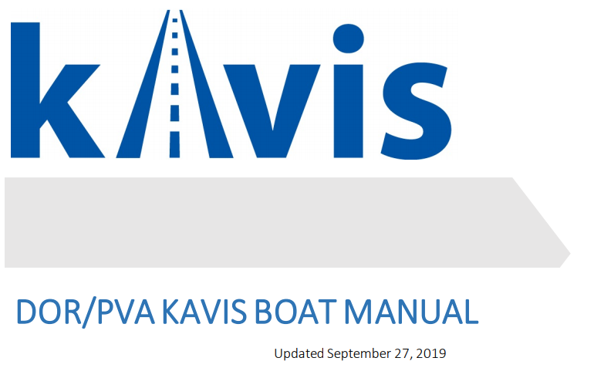
https://transportation.ky.gov/motor-vehicle-licensing/Pages/kavis2-pva.aspx
https://kavis.kytc.ky.gov/

Slide 33
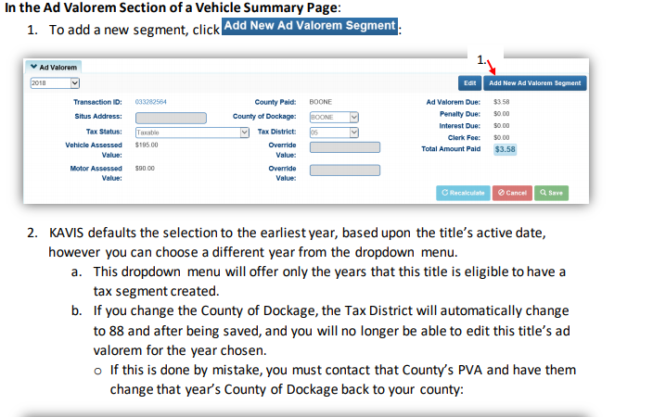
Adding a New Ad Valorem Segment

Slide 34
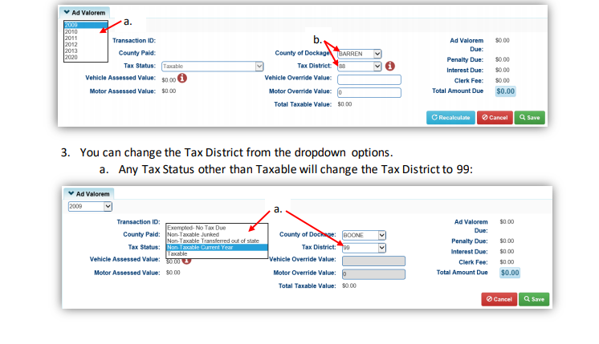
Adding a New Ad Valorem Segment (cont.)

Slide 35
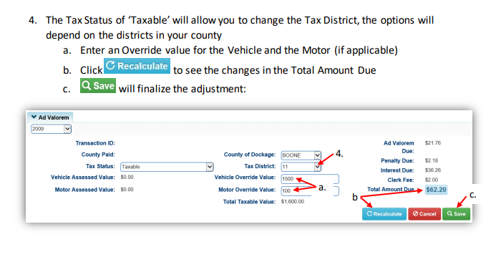
Adding a New Ad Valorem Segment (cont.)

Slide 36
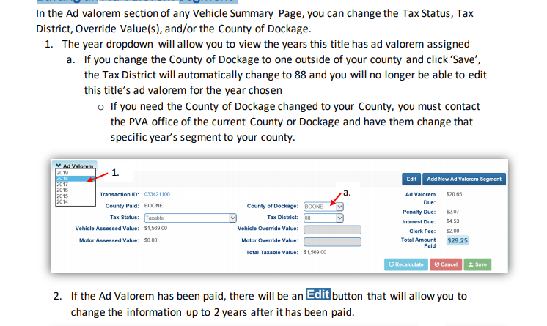
Editing an Ad Valorem Segment

Slide 37
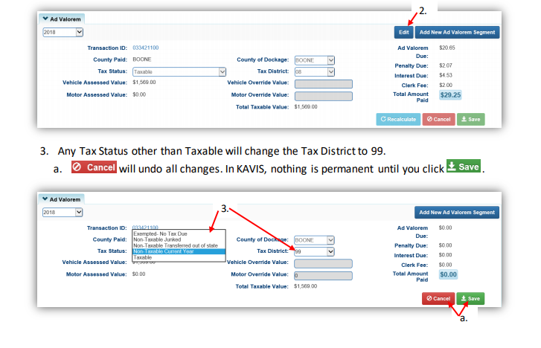
Editing an Ad Valorem Segment (cont.)

Slide 38
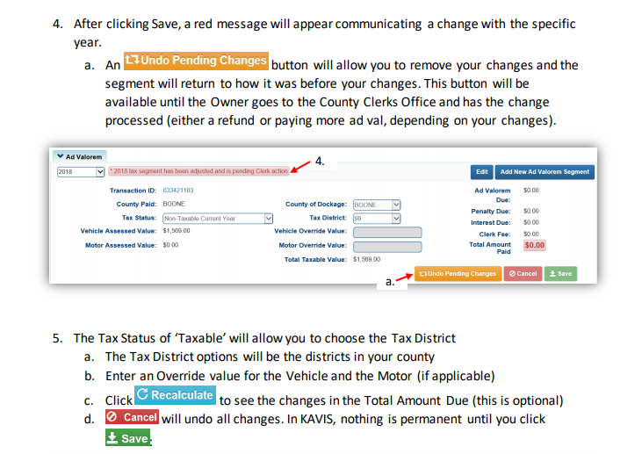
Editing an Ad Valorem Segment (cont.)

Slide 39
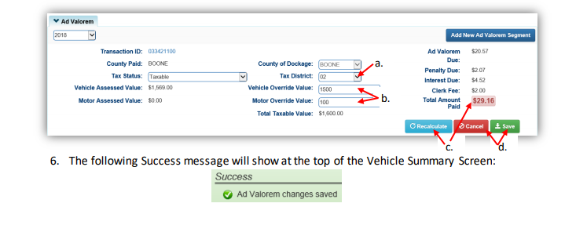
Editing an Ad Valorem Segment (cont.)

Slide 40
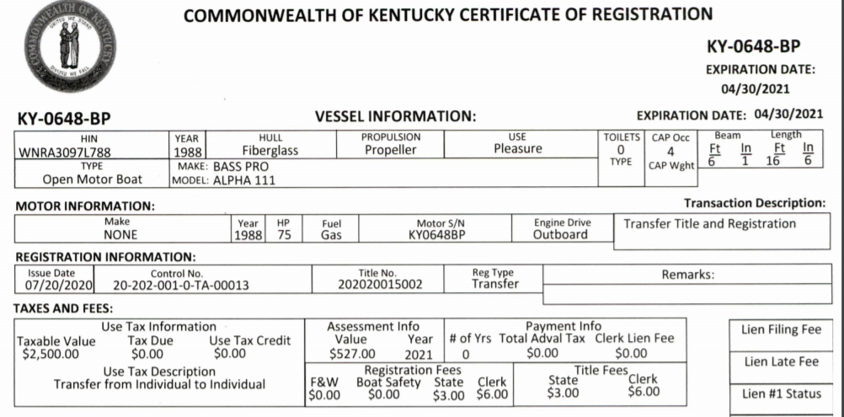
Editing an Ad Valorem Segment (cont.)
Certificate of Registration from PODD
KAVIS
The assessment info box is pulling the information from prior owner if registered in Kentucky previously.
Be sure that you check the BTR or sales invoice for the current owner and adjust the value accordingly.

Slide 41
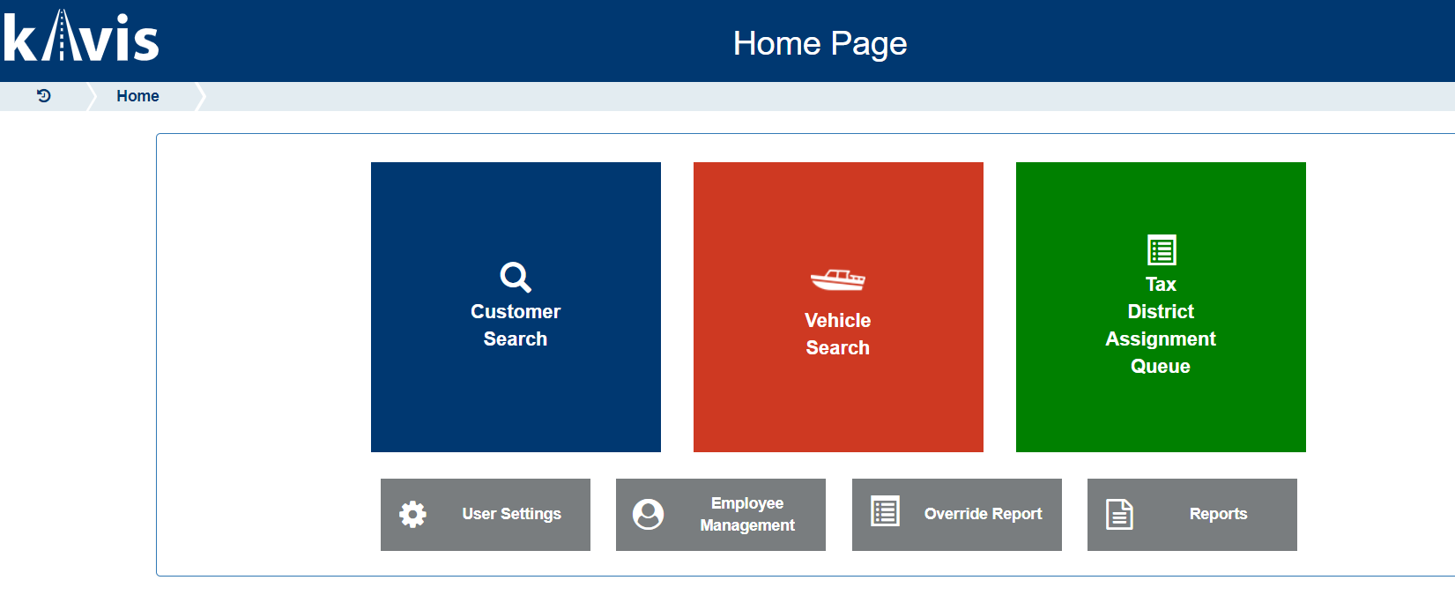
Working your Tax District Assignment Queue

Slide 42
Working your Tax District Assignment Queue
Select your county in the dropdown menu.

Slide 43
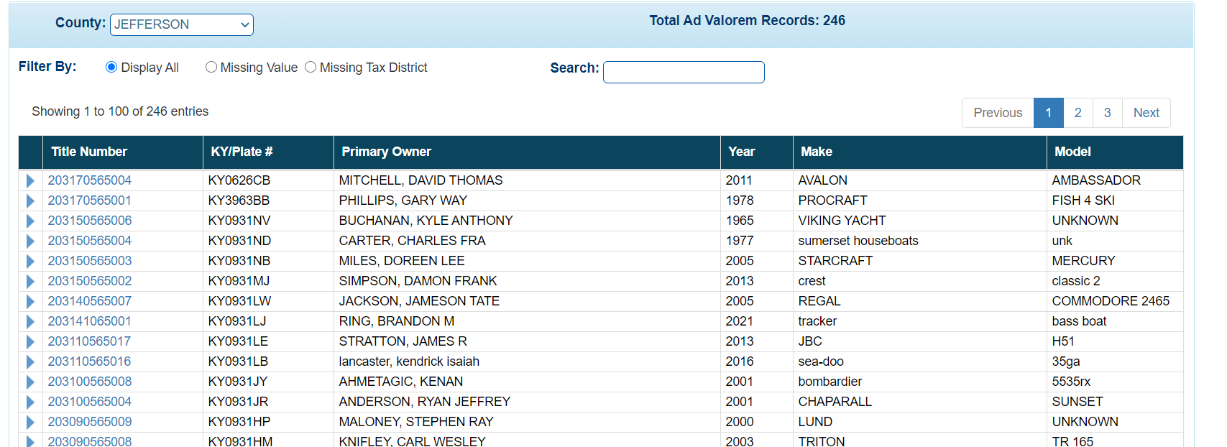
Working your Tax District Assignment Queue
Here you can see the total number of records that need to be worked.

Slide 44
Working your Tax District Assignment Queue
You have the option to filter your report by the records with a missing value, missing tax district or all records.

Slide 45
Working your Tax District Assignment Queue
This record need a value and a tax district.

Slide 46
Working your Tax District Assignment Queue
Scroll to the bottom of the page to view ‘Vehicle History’. Click on the link in the ‘Cntrol Number’ box to be directed to PODD.

Slide 47
Working your Tax District Assignment Queue
Obtain the Sale Price from the BTR.

Slide 48
Working your Tax District Assignment Queue
Input the Sale Price value from the BTR, less 5%. Hit ‘Recalculate’ and then ‘Save’.

Slide 49
Remember!
Complete as many records in the Tax District Assignment Queue as possible so that the notices are up-to-date when going out next year.
Boat valuation does not compare to NADA like motor vehicles so it is important to value as many boats as possible.
This is live and updates daily once a transfer in the Clerk’s Office takes place

Slide 50
Planned changes to KAVIS beginning 2021
KAVIS will not use the Registration state of ‘Junked’ or ‘Sold out of State’ to determine if we should build a segment. It will only use the prior year tax status to determine this. Important to have the prior year current
KAVIS will not build a row if there has not been an Ad Valorem payment for 3 years. Similar to motor vehicles.
When a transfer has occurred, KAVIS will use the Purchase Price and compare it to the carry forward value from the prior year in determining value.

Slide 51
Questions
Lindsey Brown- Section Supervisor
502-564-7384
LindseyN.Brown@ky.gov
Jehna Cornish- Branch Manager
502-782-2507
Jehna.Cornish@ky.gov

Slide 52
What to Look for when Processing your Tangibles and Valuing Boats
Jehna Cornish & Lindsey Brown
 Jehna.Cornish@ky.gov & LindseyN.Brown@ky.gov
 (502) 782-2507 & 502-564-7384
The information in this presentation is for educational and informational purposes only and does not constitute legal advice. Information is presented as an overall review that is subject to law changes and may not apply to all states. For accurate information on issues related to personal property taxation, please reference KRS 133.110, KRS 132.485 and KRS 134.590.
Information in this presentation is believed to be accurate as of the date of publication. In the event that any information in this presentation is later determined to be in error, this presentation cannot be used by taxpayers in supporting a specific position or issue before the Department of Revenue, as it does not have the statutory or regulatory authority.
Kentucky Department of Revenue • 501 High Street • Frankfort, KY 40601 • (502) 564-2557

