Slide 1
Commercial Reassessments
2020 PVA Fall Conference

Slide 2
Approaches to Value
Market: determined by sales.
Cost: determined by the depreciated cost of a building/improvement.
Income: capitalized net income.

Slide 3
Market Approach
Use recent sales from similar type properties from your county.
If you don’t have any recent sales of similar properties in your county, you can use sales from other counties.
Your DOR Field Rep should be able to assist you with finding sales on the State Commercial Sales File.

Slide 4
Example of a Sale on the State Sales File

Slide 5
State Sales File

Slide 6
Cost Approach
Using the Marshall & Swift software, you can come up with the depreciated cost of a commercial property.
If your office does not have the Marshall & Swift software, your DOR Field Rep does and they can assist you.
There is certain information that is required to accurately determine the depreciated cost using Marshall & Swift.

Slide 7
Information required for Marshall & Swift
Construction Class (Ex. Stud Frame, Masonry Bearing Walls, etc.)
Occupancy Type (Ex. Office, Retail, Fast Food, etc.)
Total Square Footage
Perimeter
Story Height
Year Built
Date of any major remodels
Exterior Wall Type (Ex. Brick, Vinyl, Concrete Block, etc.)
Type of HVAC (Ex. Heat Pump, Packaged Unit, etc.)
Blacktop or Concrete Parking Lot Square Footage
Land Value

Slide 8
Construction Class
(A) Fireproof Structural Steel Frame
(B) Reinforced Concrete Frame
(C) Masonry Bearing Walls
(D) Wood or Steel Stud Framed Exterior Walls
(H) Hoop Frame (Arch)
(M) Mill Type Construction
(P) Wood Frame and Metal Walls (Pole Frame)
(S) Metal Frame Walls
(W) Metal Slant Frame and Walls
* Classes C, D, & S being the most common

Slide 9
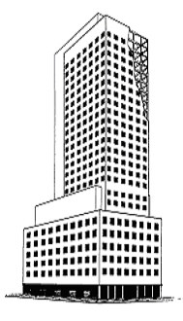
Class A – Fireproof Structural Steel Frame
The primary feature of Class A buildings is the fireproofed structural steel frame, which may be welded, bolted or riveted together.
The fireproofing may be masonry, poured concrete, plaster, sprayed fiber or any other method which gives a high fire-resistance rating.
Floor and roof in Class A structures are normally reinforced concrete on steel decking or formed slabs resting on the frame or poured to become integral with it.
They may also be composed of prefabricated panels and may be mechanically stressed.
Exterior walls are curtain walls of masonry, concrete, steel studs and stucco, or one of the many types of panels of metal, glass, masonry or concrete.

Slide 10
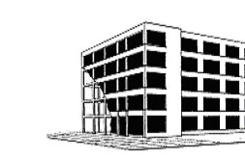
Class B – Reinforced Concrete Frame
The primary characteristic of Class B buildings is the reinforced concrete frame in which the columns and beams can be either formed or precast concrete.
They may be mechanically stressed. Class B buildings are fire-resistant structures.
Floors and roofs in Class B structures are formed or precast concrete slabs.
The exterior walls, generally, are masonry or reinforced concrete curtain walls or any of the many types of wall panels of concrete, metal, glass or stone.
In some Class B buildings the walls may be partially loadbearing.

Slide 11
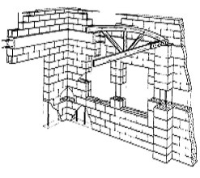
Class C – Masonry Bearing Walls
Class C buildings are characterized by masonry or reinforced concrete (including tilt-up) construction.
The walls may be loadbearing, i.e., supporting roof and upper floor loads, or nonbearing with concrete, steel or wood columns, bents or arches supporting the load.
Upper floors and roofs are supported by wood or steel joists or trusses.
Ground floors may be concrete slabs. Upper floors may be of concrete plank, steel deck or wood.
Bearing walls are frequently strengthened by concrete bond beams and pilasters.
Class C buildings are not fire-resistant structures.

Slide 12
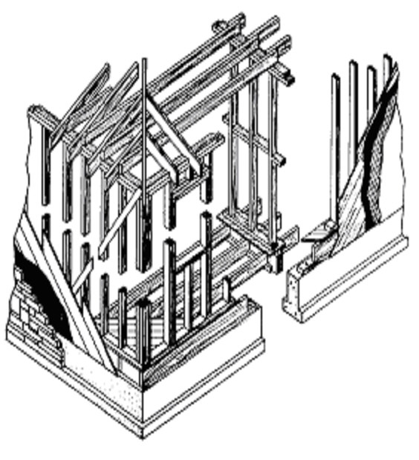
Class D – Wood or Steel Stud Framed Exterior Wall
Class D buildings are characterized by combustible construction.
The exterior walls may be made up of closely spaced wood or steel studs as in the case of a typical frame house.
Exterior covers may be wood siding, shingles, stucco, brick or stone veneer or some other type of material.
Floors and roofs are supported on wood or steel joists or trusses. The floor may be a concrete slab on the ground.

Slide 13
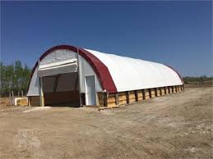
Class H – Hoop Frame (Arch)
Class H buildings (a subset of Class D) are characterized by combustible, prefabricated wood-post and tubular steel, semicircular, framed roof in a hoop (Quonset) shape.
The roof curves to a short wooden pony wall or to the ground.
The roof and walls are generally covered with canvass or a woven vinyl tarp.
Ground floors are typically dirt or can be a concrete slab.

Slide 14
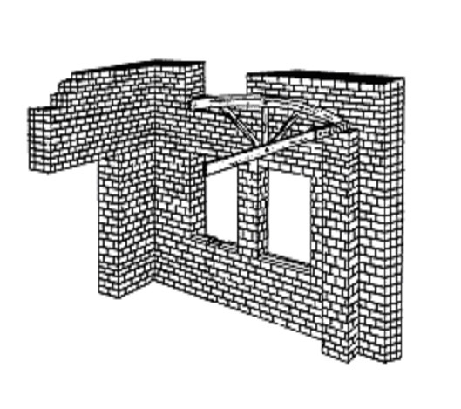
Class M – Mill Type Construction
Class M buildings are characterized by heavy masonry and timber construction.
The walls are generally thick loadbearing brick or nonbearing with open wood columns, trusses or arches supporting the load.
Floors are heavy laminated wood or a concrete slab on the ground.

Slide 15
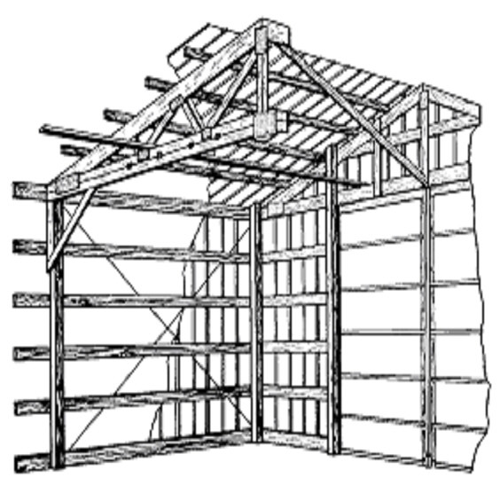
Class P – Wood Frame and Metal Walls (Pole Frame)
Class P buildings (a subset of Class D) are characterized by combustible prefabricated wood structural members.
The exterior walls may be wood studs or an open-wood-skeleton post frame with exterior coverings of prefabricated metal panels or sheet siding.
Upper floors and roof are supported on wood joists or trusses.
Ground floors are typically concrete slabs.

Slide 16
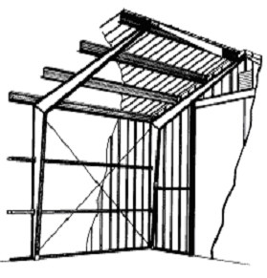
Class S – Metal Frame Walls
Class S buildings are characterized by incombustible construction and prefabricated structural members.
They are not fire-resistant buildings.
The exterior walls may be steel studs or an open-steel-skeleton frame with exterior coverings of prefabricated panels or sheet siding.
Upper floors and roof are supported on steel joists or beams.
Ground floors are typically concrete slabs.

Slide 17
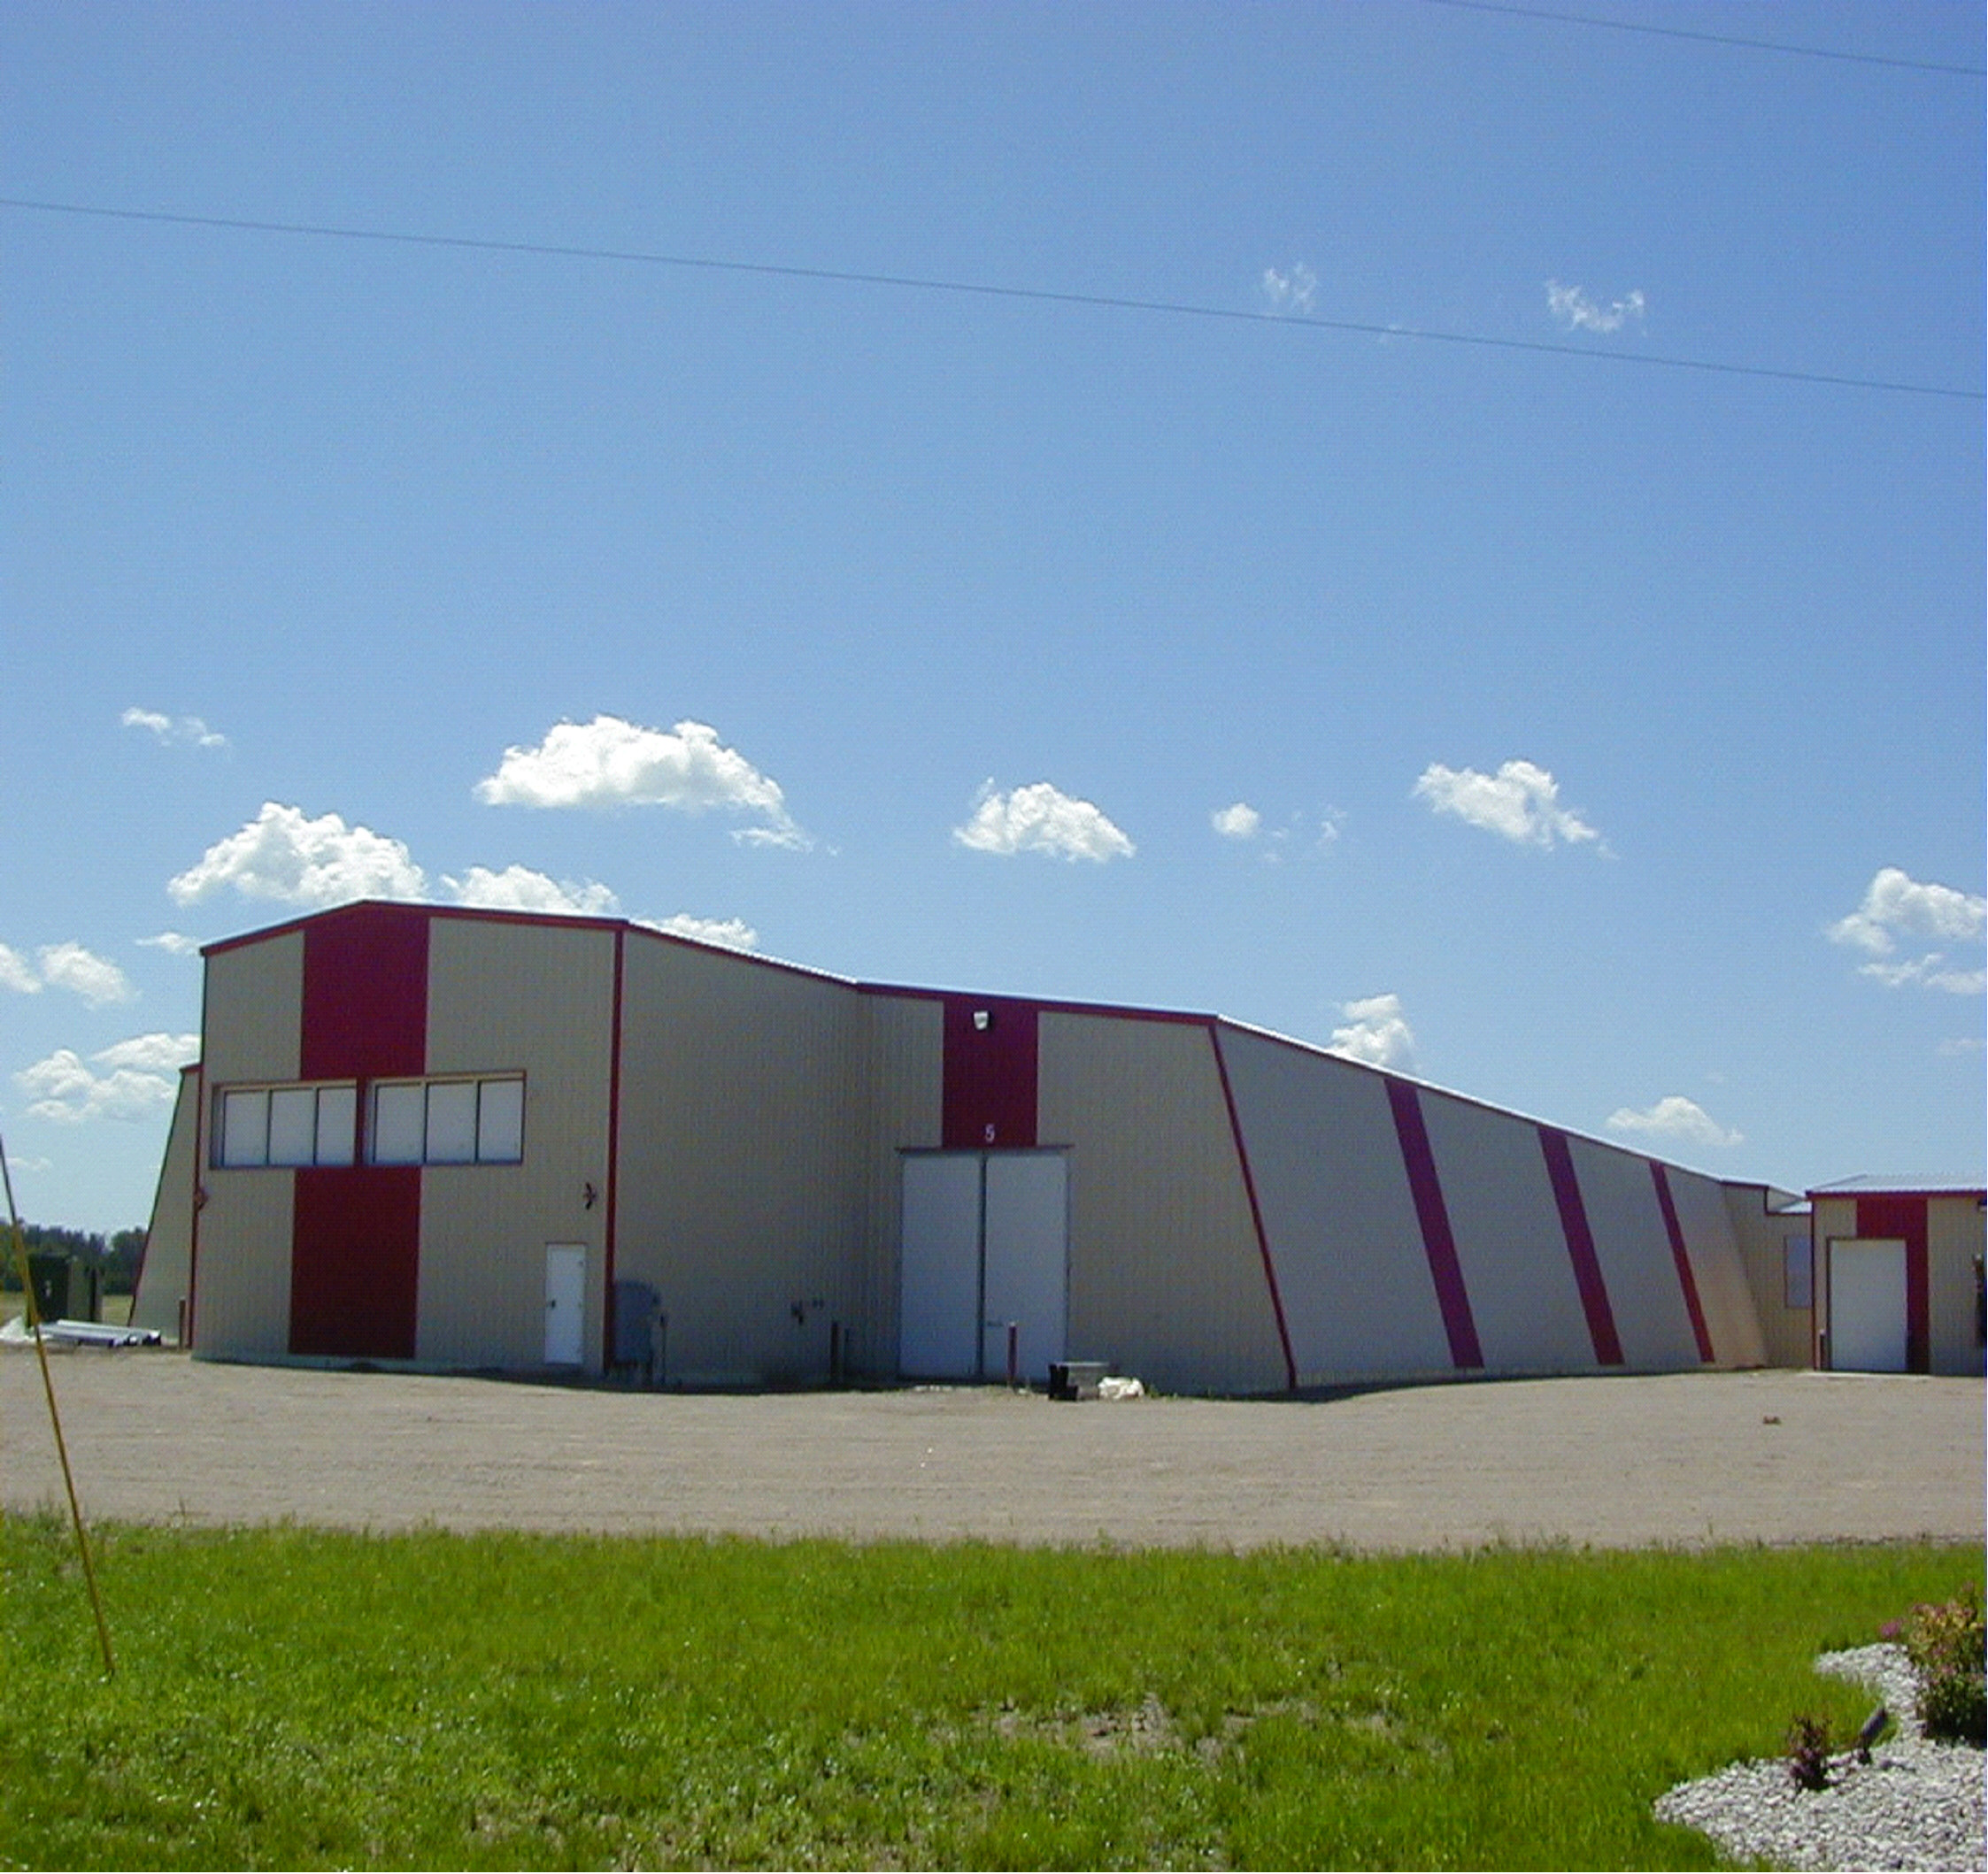
Class W – Metal Slant Frame and Walls
Class W buildings (a subset of Class S) are characterized by incombustible construction and light prefabricated structural members.
They are not fire-resistant buildings.
The exterior walls and roof coverings are prefabricated metal panels or sheet siding supported by an open-steel skeleton slant (modified A) frame.
Ground floors are typically concrete slabs.

Slide 18
Cost Rank (Quality)
The cost rank, or quality of construction, determines the level of the calculated costs.
The four basic cost ranks are:
Low (Rank 1) - These tend to be very plain buildings that conform to minimum building code requirements. Interiors are plain with little attention given to detail or finish. Typically, there are minimum mechanical and low-cost finishes throughout.
Average (Rank 2) - These buildings are the most commonly found and meet building code requirements. There is some ornamentation on the exterior with interiors having some trim items. Lighting and plumbing are adequate to service the occupants of the building.
Good (Rank 3) - These are generally well-designed buildings. Exterior walls usually have a mix of ornamental finishes. Interior walls are nicely finished and there are good quality floor covers. Lighting and plumbing include better quality fixtures.
Excellent (Rank 4) - Usually, these buildings are specially designed, have high-cost materials and exhibit excellent workmanship. Both exteriors and interiors have custom and ornamental features. Lighting and plumbing include high-cost fixtures.
In addition to the four basic ranks, you can enter ranks down to 0.5 and up to 5. Also, you can enter a cost rank between two rank numbers (e.g., 2.5 for a quality between average and good).

Slide 19
The Most Common HVAC Components
Heat Pump
Packaged Unit/Roof Top
Complete HVAC (Mainly in Restaurants)
Forced Air
Individual Thru-Wall Heat Pump (Used in Hotels/Motels)

Slide 20
The Most Common Exterior Wall Components
Brick Veneer
Metal Siding
Vinyl Siding
Stucco
Concrete Block (Regular or Textured)

Slide 21
Marshall & Swift Report

Slide 22
Income Approach
Derived from the owner’s income statement or rent from comparable properties.
Income minus Allowable Expenses.
Is the capitalization of income to determine value.

Slide 23
Determining Value from Income Stream
Potential Gross Income (or Market Rent)
 | - Vacancy and Collection Loss
 | + Miscellaneous Income
Effective Gross Income
 | - Allowable Expenses
Net Operating Income
Value = | Net Operating Income
 | Capitalization Rate (or Cap Rate)

Slide 24
Allowable Expenses
Management Fees
Insurance
Utilities
Maintenance & Repair
Legal & Accounting Fees
Employee Wages & Fringe Benefits
Yard Care
Miscellaneous Expenses
Reserve for Replacement (HVAC, Roof, etc.)

Slide 25
Non-allowable Expenses
Depreciation
Capital Improvements (Additions to Building)
Franchise Fees & Special Corporation Costs
Owner’s Personal Expenses (Income Taxes, etc.)
Debt Service (Principle & Interest on Mortgage)
Payment on loan for Capital Improvements
Property Taxes (Included in Cap Rate)

Slide 26
For a more in-depth understanding of the income approach, we recommend attending the following classes:
KY 72
IAAO 102

Slide 27
Or you could follow our lead and contact Billy “Burn It In Your Mind” Whittaker.
He is awaiting your call!

Slide 28
Our Contact Information
Ben Williams – ben.williams@ky.gov
Jeff Cress – jeffery.cress@ky.gov

Slide 29
Questions?

