Slide 1
PODD-Print on Demand Decal

Slide 2
Non-State Network PVA’S in order to access PODD you have to use the following link https://kavispoddarchivepva.kytc.ky.gov.
You have to first login using kyfd01\pv##### (for each county user). Password (NOT YOUR AVIS PASSWORD) is the password you log on your computer or email password.

Slide 3
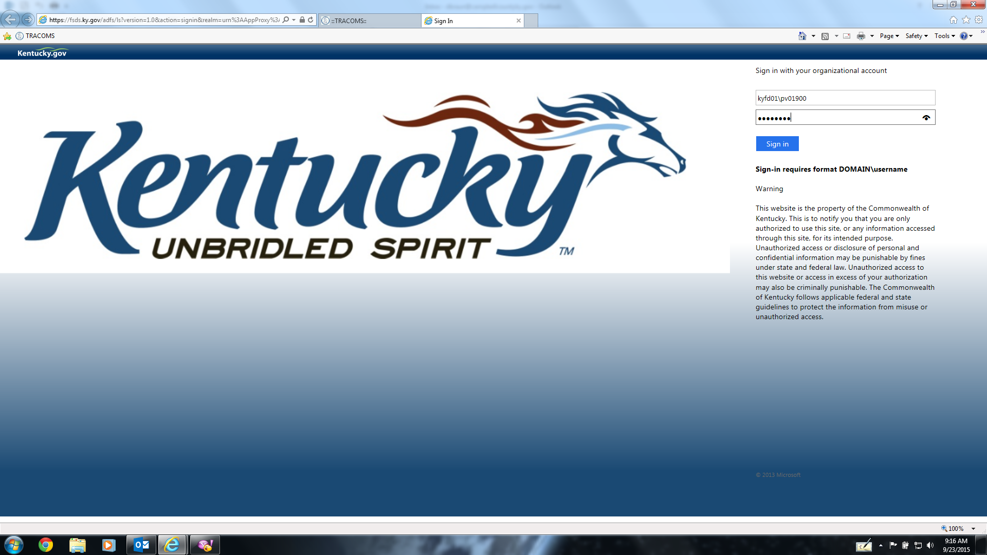

Slide 4
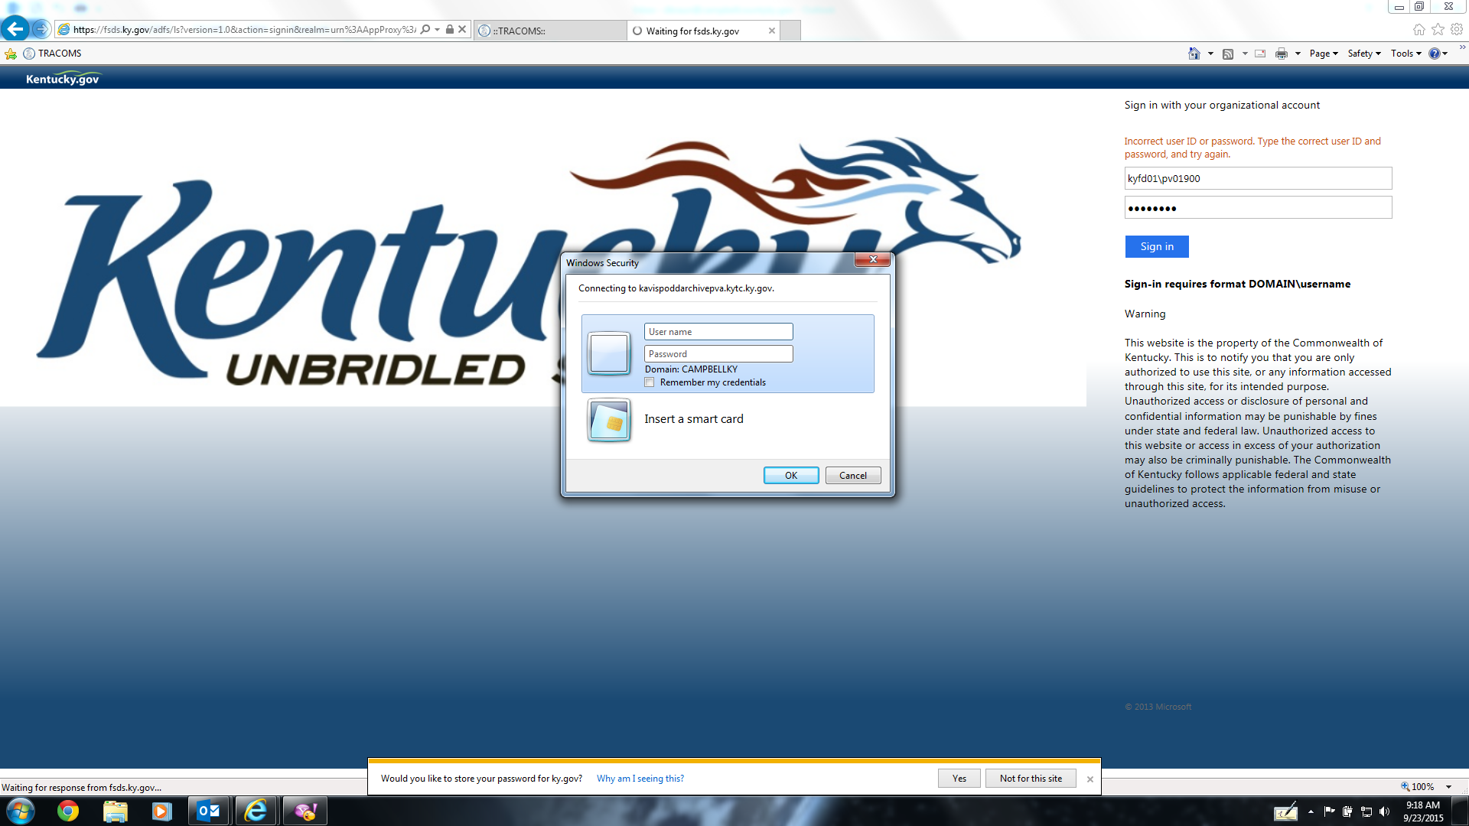
After the initial login page(previous page), it brings up another login box in the middle of the screen. Use the same login as the first login.

Slide 5
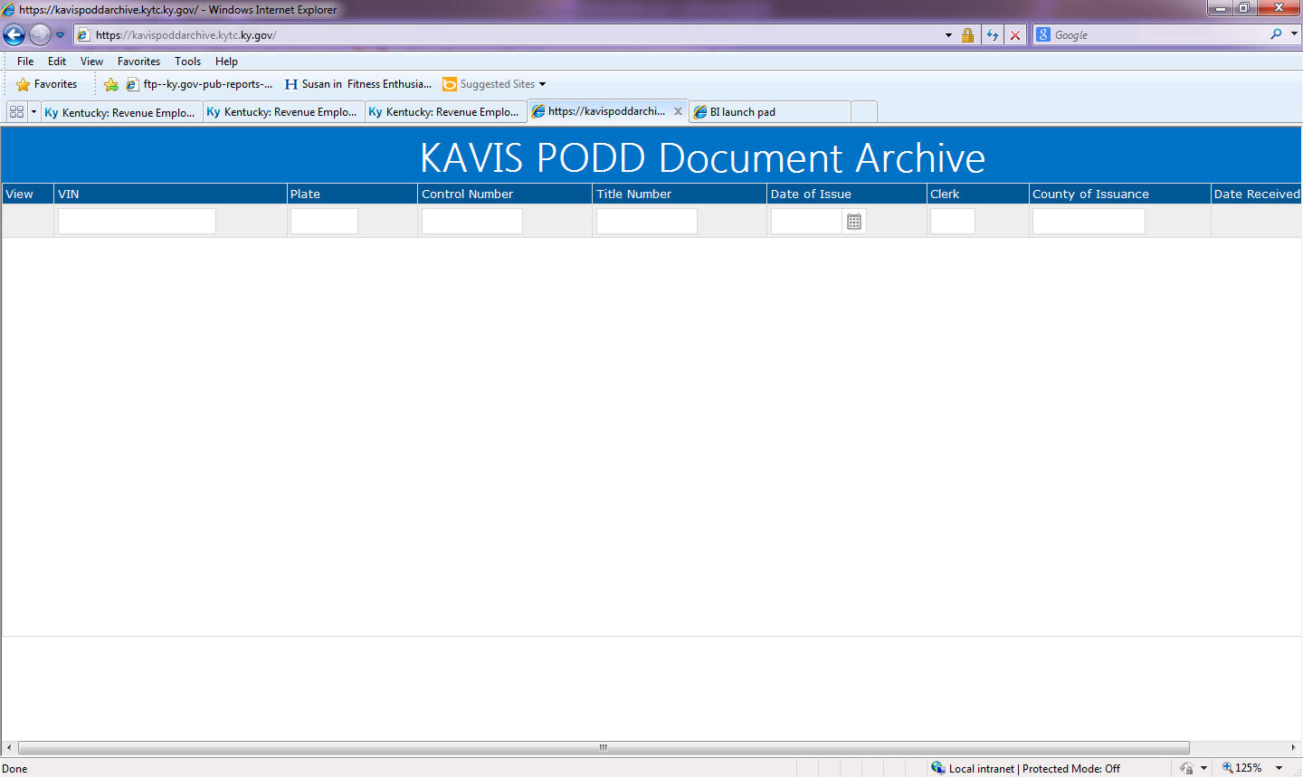
You can search by VIN#, PLATE#, CONTROL#, TITLE#, DATE of ISSUE, CLERK ID, COUNTY AND DATE RECEIVED.

Slide 6
State Network PVA’s https://kavispoddarchive.kytc.ky.gov.
Login with your PV# and password you log on your computer.
You can search by VIN#, PLATE#, CONTROL#, and TITLE #, DATE of ISSUE, Clerk ID, County, and Date Received

Slide 8
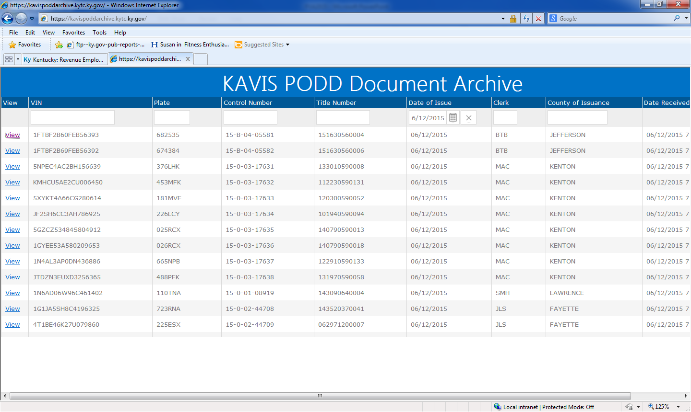
TO VIEW THE DOCUMENTS CLICK ON “VIEW”

Slide 9
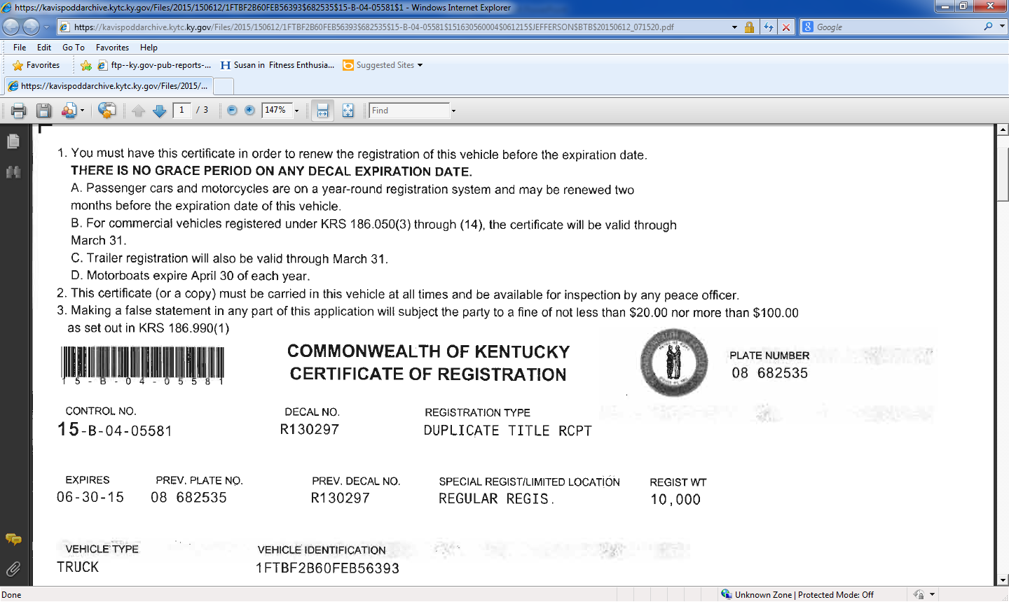

Slide 10
